Slide 1
Lecture-2
Matrix Inverse

Slide 2
Objective:
How to find the inverse of a matrix
How to convert a matrix to Row Echelon Form (REF) & Reduced Row Echelon Form (RREF)
How to calculate rank of a matrix
Methodology:
There are two ways to find the inverse of a matrix
Using cofactor method and
Using elementary row operations

Slide 3
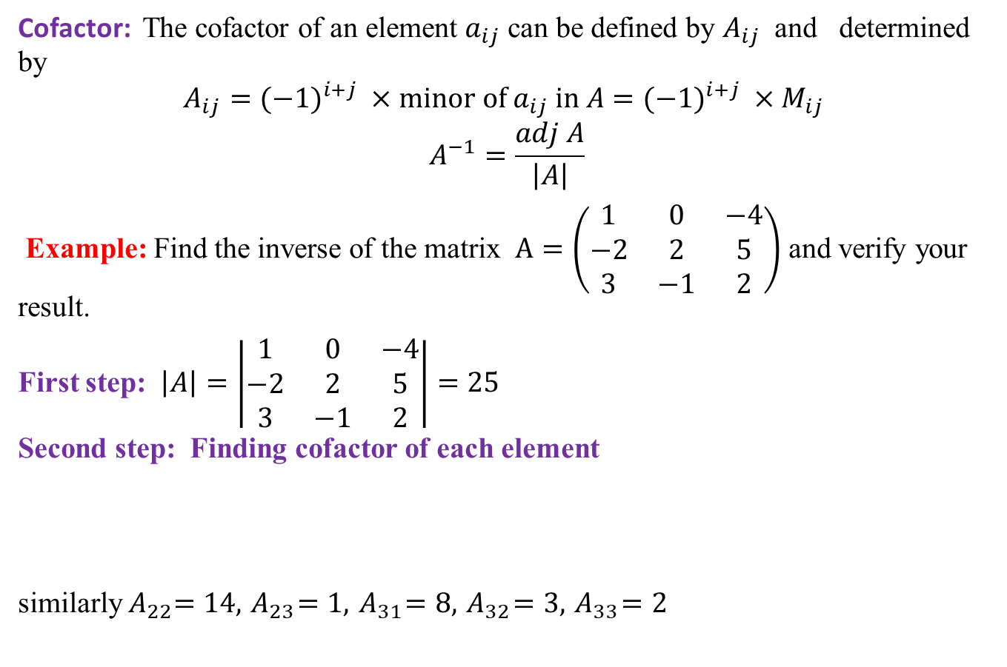
Inverse of a Matrix
Cofactor: The cofactor of an element $a_{ij}$ can be defined by $A_{ij}$ and determined by
$$A_{ij}=(−1)^{i+j} ×minor of a_{ij} in A=(−1)^{i+j} ×M_{ij}$$
$$A^{−1}=\frac{adj A}{\left|A\right|}$$
Example: Find the inverse of the matrix $A=\left(\begin{matrix}1 & 0 & −4 \\ −2 & 2 & 5 \\ 3 & −1 & 2\end{matrix}\right)$ and verify your result.
First step: $\left|A\right|=\left|\begin{matrix}1 & 0 & −4 \\ −2 & 2 & 5 \\ 3 & −1 & 2\end{matrix}\right|=25$
Second step: Finding cofactor of each element
similarly${ A}_{22}=14,{ A}_{23}=1,{ A}_{31}=8,{ A}_{32}=3,{ A}_{33}=2$

Slide 4

Inverse (Continued)
Third step:
$={coft}^{T} ={\left[ \begin{matrix}9 & 19 & −4 \\ 4 & 14 & 1 \\ 8 & 3 & 2\end{matrix}\right]}^{T}=\left[\begin{matrix}9 & 4 & 8 \\ 19 & 14 & 3 \\ −4 & 1 & 2\end{matrix}\right]$.
$A^{−1}=\frac{adj A}{|A|}=\frac{1}{25}\left[\begin{matrix}9 & 4 & 8 \\ 19 & 14 & 3 \\ −4 & 1 & 2\end{matrix}\right]$
Verification: $AA^{−1}=I=A^{−1}A$
$$A^{−1}A=\frac{1}{25}\left[\begin{matrix}9 & 4 & 8 \\ 19 & 14 & 3 \\ −4 & 1 & 2\end{matrix}\right]\left[\begin{matrix}1 & 0 & −4 \\ −2 & 2 & 5 \\ 3 & −1 & 2\end{matrix}\right]=\frac{1}{25}\left[\begin{matrix}25 & 0 & 0 \\ 0 & 25 & 0 \\ 0 & 0 & 25\end{matrix}\right]=\left[\begin{matrix}1 & 0 & 0 \\ 0 & 1 & 0 \\ 0 & 0 & 1\end{matrix}\right]$$
.

Slide 5
Reduced Row Echelon Form (RREF)
Row Echelon Form (REF)
A matrix is in row echelon form when it satisfies the following conditions.
Nonzero rows (rows with at least one nonzero element) are above any rows of all zeros.
The leading coefficient (the first nonzero number from the left, also called the pivot) of a nonzero row is always strictly to the right of the leading coefficient of the row above it.
Reduced Row Echelon Form (RREF)
A matrix is in reduced row echelon form (also called row canonical form) if it satisfies the additional condition
The first non-zero element in each row, called the leading entry, is 1, that is, very leading co-efficient is 1 and is the only nonzero entry in this column.
The following matrix is in row echelon form, but not in reduced row echelon form

Slide 6

Example
$\left[\begin{matrix}2 & 3 & −4 \\ −3 & 7 & 0 \\ −5 & 3 & 7\end{matrix}\right]$ is not in row echelon form
$\left[\begin{matrix}1 & 9 & 1 \\ 0 & 0 & 1 \\ 0 & 0 & 0\end{matrix} \begin{matrix}1 \\ 2 \\ 1\end{matrix}\right]$is in row echelon form, but not in reduced row echelon form
$\left[\begin{aligned}\begin{matrix}1 & 0 & 0 \\ 0 & 1 & 0 \\ 0 & 0 & 1\end{matrix} \begin{matrix}0 \\ 0 \\ 0\end{matrix} \\ \begin{matrix}0 & 0 \end{matrix}\begin{matrix}0 & 0\end{matrix}\end{aligned}\right]$in reduced row-echelon form

Slide 7
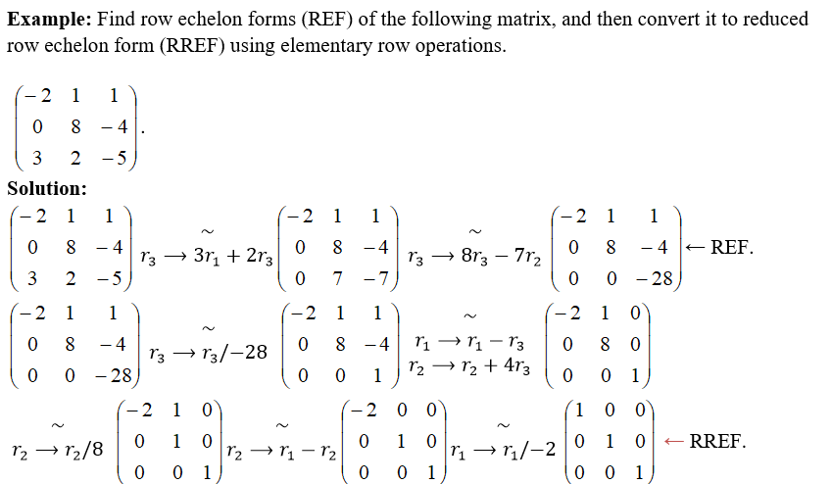
REF & RREF

Slide 8
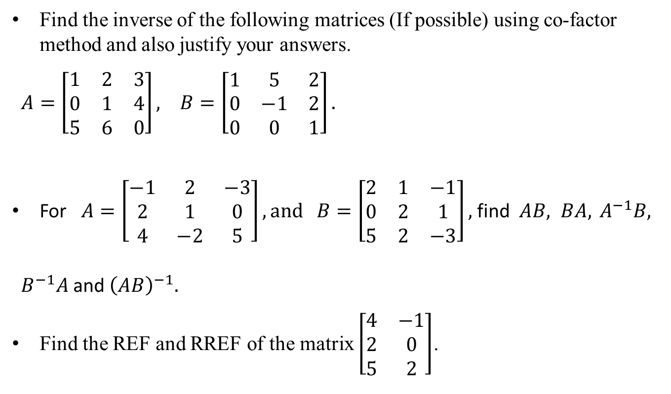
Sample Question
Find the inverse of the following matrices (If possible) using co-factor method and also justify your answers.
$A=\left[\begin{matrix}1 & 2 & 3 \\ 0 & 1 & 4 \\ 5 & 6 & 0\end{matrix}\right], B=\left[\begin{matrix}1 & 5 & 2 \\ 0 & −1 & 2 \\ 0 & 0 & 1\end{matrix}\right].$
For $A=\left[\begin{matrix}−1 & 2 & −3 \\ 2 & 1 & 0 \\ 4 & −2 & 5\end{matrix}\right], and B=\left[\begin{matrix}2 & 1 & −1 \\ 0 & 2 & 1 \\ 5 & 2 & −3\end{matrix}\right],$ find $AB, BA, { A}^{−1}B,$
$B^{−1}A$and ${\left(AB\right)}^{−1}.$
Find the REF and RREF of the matrix $\left[\begin{matrix}4 & −1 \\ 2 & 0 \\ 5 & 2\end{matrix}\right]$.

Slide 9
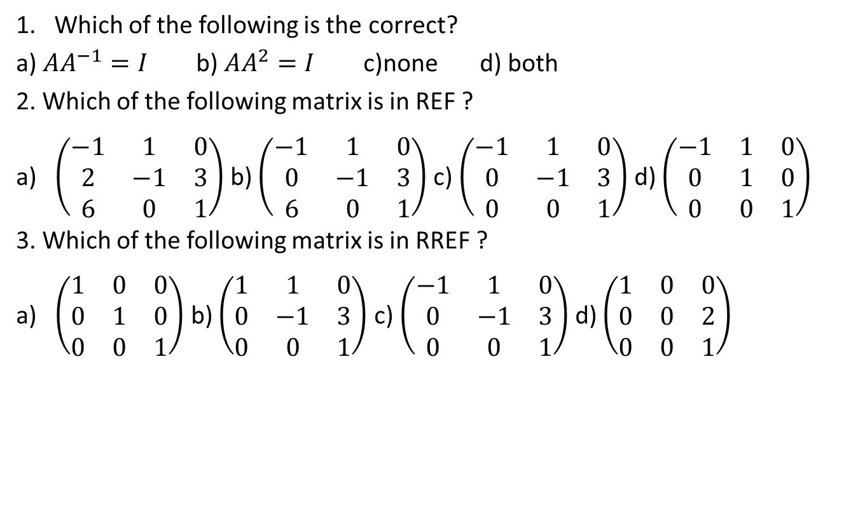
Sample MCQ
1. Which of the following is the correct?
a) $AA^{−1}=I$ b) $AA^{2}=I$ c)none d) both
2. Which of the following matrix is in REF ?
a) $\left(\begin{matrix}−1 & 1 & 0 \\ 2 & −1 & 3 \\ 6 & 0 & 1\end{matrix}\right)$ b) $\left(\begin{matrix}−1 & 1 & 0 \\ 0 & −1 & 3 \\ 6 & 0 & 1\end{matrix}\right)$ c) $\left(\begin{matrix}−1 & 1 & 0 \\ 0 & −1 & 3 \\ 0 & 0 & 1\end{matrix}\right)$ d) $\left(\begin{matrix}−1 & 1 & 0 \\ 0 & 1 & 0 \\ 0 & 0 & 1\end{matrix}\right)$
3. Which of the following matrix is in RREF ?
a) $\left(\begin{matrix}1 & 0 & 0 \\ 0 & 1 & 0 \\ 0 & 0 & 1\end{matrix}\right)$ b) $\left(\begin{matrix}1 & 1 & 0 \\ 0 & −1 & 3 \\ 0 & 0 & 1\end{matrix}\right)$ c) $\left(\begin{matrix}−1 & 1 & 0 \\ 0 & −1 & 3 \\ 0 & 0 & 1\end{matrix}\right)$ d) $\left(\begin{matrix}1 & 0 & 0 \\ 0 & 0 & 2 \\ 0 & 0 & 1\end{matrix}\right)$

Slide 10
Outcome
After this lecture students
Will know how to find the inverse of a matrix
Will be able to convert a matrix to REF
Will be able to convert a matrix to RREF

Slide 11
Next class
Finding inverse using elementary row operation
Introduction to system of linear equation
Solving linear equation using Gaussian elimination

